Slide 1
The Ethernet Specifications

Slide 2
Table of Contents
Ethernet Basics
Ethernet as the Data Link Layer

Slide 3
Ethernet Basics
1
Ethernet
Collision Domain
Broadcast Domain
CSMA/CD
Broadband/Baseband

Slide 4
Ethernet Basics
Ethernet
The technology for connecting devices in a network
Describes how network devices can format and transmit data
Uses both Data Link and Physical layer specifications
Institute of Electrical and Electronics Engineers (IEEE) defines Ethernet as protocol 802.3
Notes:
Ethernet is the traditional technology for connecting devices in a wired local area network (LAN) or wide area network (WAN), enabling them to communicate with each other via a protocol -- a set of rules or common network language. Ethernet describes how network devices can format and transmit data so other devices on the same local area network segment can recognize, receive and process the information. An Ethernet cable is the physical, encased wiring over which the data travels.
Connected devices accessing a geographically localized network with a cable likely use Ethernet. From businesses to gamers, diverse end users depend on the benefits of Ethernet connectivity, which include reliability and security.
Compared to wireless LAN (WLAN) technology, Ethernet is typically less vulnerable to disruptions. It can also offer a greater degree of network security and control than wireless technology since devices must connect using physical cabling. This makes it difficult for outsiders to access network data or hijack bandwidth for unsanctioned devices.

Slide 5
Ethernet Basics
Ethernet
Bandwidth | Common Name | Informal name | IEEE name | Cable Type
10 Mbps | Ethernet | 10Base-T | 802.3 | UTP 100m
100 Mbps | Fast Ethernet | 100Base-T | 802.3u | UTP 100m
1000 Mbps | Gigabit Ethernet | 1000Base-LX | 802.3z | Fiber 5000m
1000 Mbps | Gigabit Ethernet | 1000Base-T | 802.3ab | UTP 100m
10 Gbps | 10 Gigabit Ethernet | 10GBase-T | 802.3an | UTP 100m
Notes:
An overview of some popular Ethernet standards

Slide 6
Ethernet Basics
Collision Domain
The term collision domain is used to describe a part of a network where packet collisions can occur
Collisions occur when two devices on a shared network segment send packets simultaneously
The colliding packets must be discarded and sent again, which reduces network efficiency
Notes:
The term collision domain is used to describe a part of a network where packet collisions can occur. Packet collisions occur when two devices on a shared network segment send packets simultaneously. The colliding packets must be discarded and sent again, which reduces network efficiency.

Slide 7
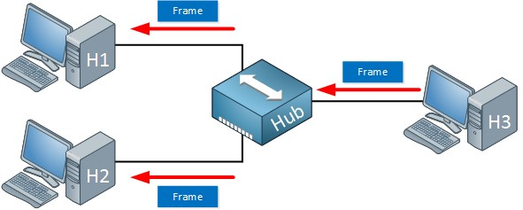
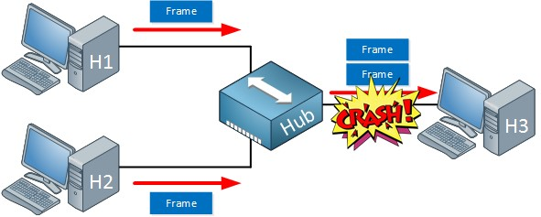
Ethernet Basics
Collision Domain
Occurs often in a hub environment
1
2
Notes:
Collisions occur often in a hub environment because all devices connected to the hub are in the same collision domain. Only one device may transmit at time, and all the other devices connected to the hub must listen to the network in order to avoid collisions. Total network bandwidth is shared among all devices.
In contrast to hubs, every port on a bridge, switch, or a router is in a separate collision domain. This eliminates the possibility of collisions and enables the devices to use the full-duplex mode of communication, which effectively doubles the maximum data capacity.

Slide 8
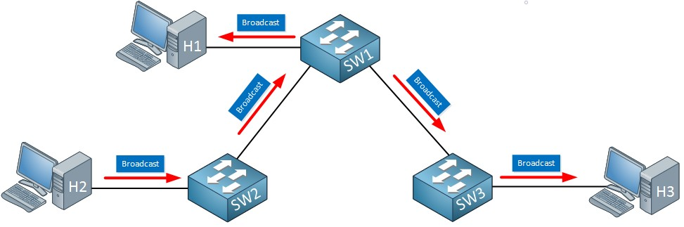
Ethernet Basics
Broadcast Domain
A broadcast domain is a collection of network devices that receive broadcast traffic from each other
1 broadcast domain
Notes:
A broadcast domain is a collection of network devices that receive broadcast traffic from each other.
All the devices present in broadcast domain have to pay attention to it. This creates a lot of congestion in the network, commonly called LAN congestion, which affects the bandwidth of the users present in that network.

Slide 9
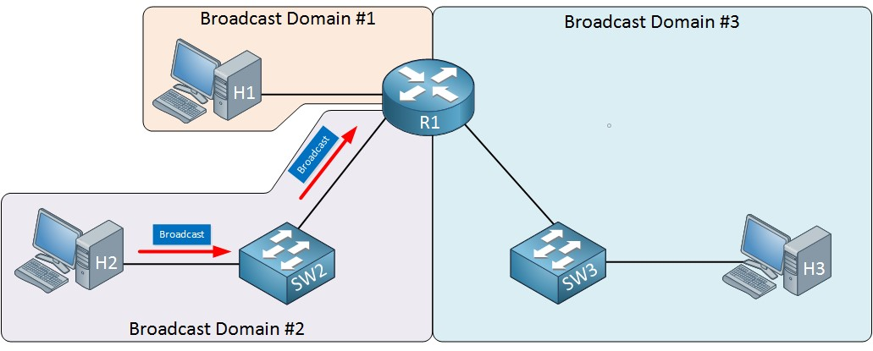
Ethernet Basics
Broadcast Domain
The more broadcast domains the more efficient network
Notes:
From this, we can realize that more the number of collision domains and more the number of broadcast domains, the more efficient is the network providing better bandwidth to all its users.
You can divide one big broadcast domain into smaller ones by using a router. We will talk about what a router is and what it does in the Network Devices lesson.

Slide 10
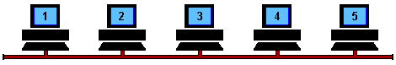
Ethernet Basics
CSMA/CD
Carrier Sense Multiple Access/Collision Detection is the protocol that is used to detect collisions and to re-transmit frames
Only bridges, switches, and routers, but not hubs, can effectively prevent a transmission from propagating throughout the entire network
Notes:
As we said earlier, everything that is connected to a hub is a single collision domain. Because of these collisions, we have to use half duplex. We can’t send and transmit at the same time. CSMA/CD is the protocol that is used to detect collisions and to re-transmit frames.
CSMA/CD is a simple protocol. All computers to the network will listen to see if someone is transmitting. When we want to send something and nobody is transmitting, we can transmit a frame. This is half duplex; we can’t transmit and receive at the same time. When two computers decide they can transmit, we still get a collision. CSMA/CD also describes how we can re-transmit a frame.
CSMA/CD is done by our computers but not by the hub; it’s only a dumb physical repeater.
When a host wants to transmit over the network, it first checks for the presence of a digital signal on the wire. If all is clear, meaning that no other host is transmitting, the host will then proceed with its transmission. But it doesn’t stop there. The transmitting host constantly monitors the wire to make sure no other hosts begin transmitting. If the host detects another signal on the wire, it sends out an extended jam signal that causes all hosts on the segment to stop sending data (think busy signal). The hosts respond to that jam signal by waiting a while before attempting to transmit again. Backoff algorithms, represented by the clocks counting down on either side of the jammed devices, determine when the colliding stations can retransmit. If collisions keep occurring after 15 tries, the hosts attempting to transmit will then time out.

Slide 11
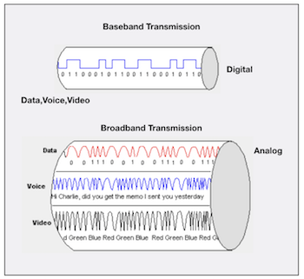
Ethernet Basics
Broadband/Baseband
Baseband
- Uses digital signals and single
channel
- Communication is bidirectional
- Short distance
Broadband
- Uses analog signals
- Multiple transmissions are possible
- Communication is unidirectional
- Long distance
Notes:
In Baseband, data is sent as digital signals through the media as a single channel that uses the entire bandwidth of the media. Baseband communication is bi-directional, which means that the same channel can be used to send and receive signals.
Broadband sends information in the form of an analog signal. Each transmission is assigned to a portion of the bandwidth, hence multiple transmissions are possible at the same time. Broadband communication is unidirectional, so in order to send and receive, two pathways are needed. This can be accomplished either by assigning a frequency for sending and assigning a frequency for receiving along the same cable or by using two cables, one for sending and one for receiving.
Baseband is used for short distance data transfer. Entire bandwidth of the cable is used for single signal transmission. Common Ethernet Standards use Baseband for LAN data transfer.
Broadband is used for long distance data transfer. Entire bandwidth of the cable is used for multiple signal transmission at different frequencies. Home Internet connection and TV cables use broadband for data transfer.
If you are using a broadband internet connection for your home internet, the signals from your internet service provider up to your broadband router are broadband signals. But, the signals used inside your Ethernet Local Area Network (LAN) are baseband signals.

Slide 12
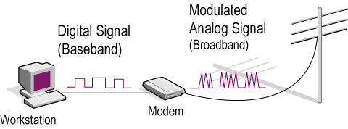
Ethernet Basics
Broadband/Baseband
If you are using a broadband internet connection for your home internet, the signals from your ISP up to your broadband router are broadband signals. But, the signals used inside your Ethernet LAN are baseband signals.
Notes:
If you are using a broadband internet connection for your home internet, the signals from your internet service provider up to your broadband router are broadband signals. But, the signals used inside your Ethernet Local Area Network (LAN) are baseband signals.

Slide 13
Ethernet at the Data Link Layer
2
Binary to Decimal and Hexadecimal Conversion
Ethernet Addressing
Ethernet Frames
Ethernet II Frames

Slide 14
Ethernet at the Data Link Layer
Binary to Decimal and Hexadecimal Conversion
Ethernet at the Data Link layer is responsible for:
Ethernet addressing (hardware or MAC addressing)
framing packets received from the Network layer
Ethernet MAC addresses are made up of hexadecimal addresses
Notes:
Ethernet at the Data Link layer is responsible for Ethernet addressing, commonly referred to as hardware addressing or MAC addressing. Ethernet is also responsible for framing packets received from the Network layer and preparing them for transmission on the local network through the Ethernet contention media-access method known as CSMA/CD.
Ethernet MAC addresses are made up of hexadecimal addresses.

Slide 15
Ethernet at the Data Link Layer
Binary to Decimal and Hexadecimal Conversion
1 bit
1 nibble
4 bits
1
0
1 byte
8 bits
Notes:
Understanding the differences between binary, decimal, and hexadecimal numbers and how to convert one format into the other is very important before discussing the TCP/IP protocol stack and IP addressing in further. So let’s get started with binary numbering. You already know that one bit is either a 1 (one) or a 0 (zero). Typically, you count either 4 or 8 bits together, with these being referred to as a nibble and a byte, respectively.

Slide 16
Ethernet at the Data Link Layer
Binary to Decimal Conversion
Binary Value | Decimal Value
10000000 | 128
11000000 | 192
11100000 | 224
11110000 | 240
11111000 | 248
11111100 | 252
11111110 | 254
11111111 | 255
Notes:
It is strongly advised that you memorize the table before braving the IP sections in further lessons since this lists all available subnet masks.
This table shows binary to decimal conversion

Slide 17
Ethernet at the Data Link Layer
Binary to Decimal and Hexadecimal Conversion
Binary Value | Hexadecimal Value | Decimal Value
0000 | 0 | 0
0001 | 1 | 1
0010 | 2 | 2
0011 | 3 | 3
0100 | 4 | 4
0101 | 5 | 5
0110 | 6 | 6
0111 | 7 | 7
Binary Value | Hexadecimal Value | Decimal Value
1000 | 8 | 8
1001 | 9 | 9
1010 | A | 10
1011 | B | 11
1100 | C | 12
1101 | D | 13
1110 | E | 14
1111 | F | 15
Notes:
Hexadecimal addressing is completely different than binary or decimal—it’s converted by reading nibbles, not bytes. By using a nibble, we can convert these bits to hex pretty simply. First, understand that the hexadecimal addressing scheme uses only the numbers 0 through 9. And because the numbers 10, 11, 12, and so on can’t be used (because they are two-digit numbers), the letters A, B, C, D, E, and F are used to represent 10, 11, 12, 13, 14, and 15, respectively.

Slide 18
Ethernet at the Data Link Layer
Binary to Decimal and Hexadecimal Conversion
Example:
What is the binary value of 0x4E (or 4Eh)?
(0x and h means that the value is hexadecimal or hex)
binary:
4 = 0100
E = 1110
01001110

Slide 19
Binary to Decimal and Hexadecimal Conversion
What is the binary value of 27h?
Ethernet at the Data Link Layer
Notes:
🍐 This is a Pear Deck Text Slide
🍐 To edit the type of question, go back to the "Ask Students a Question" in the Pear Deck sidebar.
Transition Template
Transitions between class periods or between activities within a class period can be times for confusion and chaos - it’s an easy time for students to become distracted, and before you know it, you’ve lost their attention. Help students know what to expect by using this slide to articulate clear steps for wrapping up one activity and prepare for the next. Try to keep the list to no more than three steps if you can.
Answer is: 0010 0111

Slide 20
Binary to Decimal and Hexadecimal Conversion
What is the binary value of 0xF9?
Ethernet at the Data Link Layer
Notes:
🍐 This is a Pear Deck Text Slide
🍐 To edit the type of question, go back to the "Ask Students a Question" in the Pear Deck sidebar.
Transition Template
Transitions between class periods or between activities within a class period can be times for confusion and chaos - it’s an easy time for students to become distracted, and before you know it, you’ve lost their attention. Help students know what to expect by using this slide to articulate clear steps for wrapping up one activity and prepare for the next. Try to keep the list to no more than three steps if you can.
Answer is: 1111 1001

Slide 21
Ethernet at the Data Link Layer
Ethernet Addressing
MAC (Media Access Control) Address
48-bit (6 bytes or 12-digit hex) hardware number
unique
embedded into the network card, not changeable
represented as 00:1A:3F:D3:2C:11 or 00-1A-3F-D3-2C-11
00 | 1A | 3F | D3 | 2C | 11
Organizationally Unique Identifier (OUI) Network Interface Controller Specific
Notes:
Ethernet addresses are called MAC (Media Access Control) addresses. Each network device has a unique MAC address. When we send an Ethernet frame, we add our own MAC address as the source and the receiver MAC address as the destination.
MAC Addresses are unique 48-bits hardware number of a computer, which is embedded into the network card (known as Network Interface Card) during the time of manufacturing. MAC Address is also known as the Physical Address of a network device.
https://standards.ieee.org/products-services/regauth/oui/index.html

Slide 22
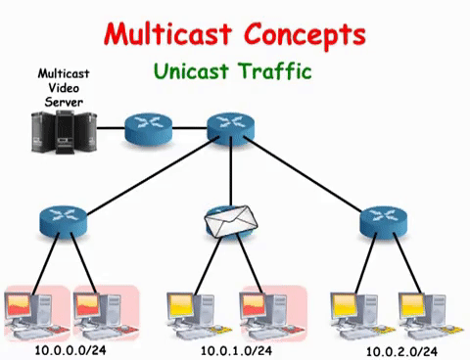
Ethernet at the Data Link Layer
Types of MAC Address
1. Unicast:
A specific NIC on the network
Only one sender and only one receiver
Notes:
Unicast MAC address represents a specific NIC or onboard NIC ports in the network. The inbuilt MAC address of a NIC is the unicast MAC address of that NIC.
In Unicast type of communication, there is only one sender, and only one receiver.

Slide 23
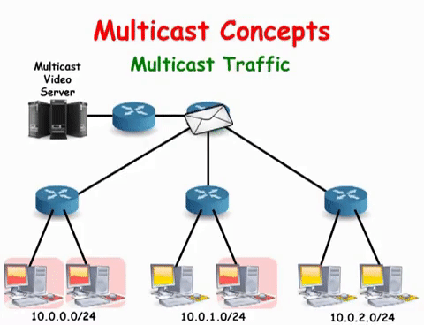
Ethernet at the Data Link Layer
Types of MAC Address
2. Multicast:
A group of receivers
OUI is 01:00:5E
Notes:
Multicast is a type of communication where multicast traffic addressed for a group of devices on the network

Slide 24
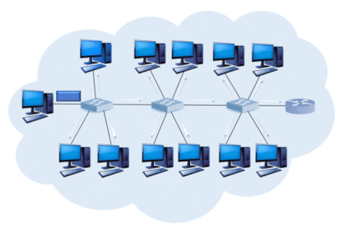
Ethernet at the Data Link Layer
Types of MAC Address
3. Broadcast:
All devices on the network are recipients
MAC Address is:
FF:FF:FF:FF:FF:FF
Notes:
Broadcast MAC address represents all devices in the network. The IEEE has reserved the address FFFF.FFFF.FFFF as the broadcast MAC address. Any device that wants to send the data to all devices of the network, can use this address as the destination MAC address.

Slide 25
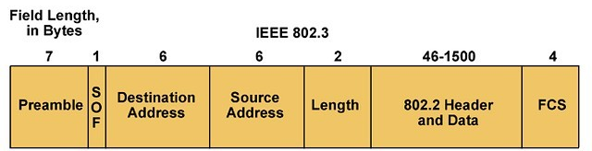
Ethernet at the Data Link Layer
Ethernet Frames
Encapsulated data defined by the Network Access layer is called an Ethernet frame
The Ethernet frame structure is defined in the IEEE 802.3 standard
Notes:
In an Ethernet network, devices share data using packets. They contain, among other things, the Ethernet frame, which is divided into several data sets. These records consist of binary code that provides important information, such as addresses, control information, payload data, and checksums.
Depending on the Ethernet standard, Ethernet frames are structured differently and may contain more or fewer data fields, depending on the network protocol.
It’s not crucial to know the contents of the Ethernet frame. But in case some of you wonder, I’ll simply put the contents.
PREAMBLE – Ethernet frame starts with 7-Bytes Preamble. This is a pattern of alternative 0’s and 1’s which indicates starting of the frame and allow sender and receiver to establish bit synchronization. Initially, PRE (Preamble) was introduced to allow for the loss of a few bits due to signal delays. But today’s high-speed Ethernet don’t need Preamble to protect the frame bits. PRE (Preamble) indicates the receiver that frame is coming and allow the receiver to lock onto the data stream before the actual frame begins.
Start of frame delimiter (SFD or SOF) – This is a 1-Byte field which is always set to 10101011. SFD indicates that upcoming bits are starting of the frame, which is the destination address. Sometimes SFD is considered the part of PRE, this is the reason Preamble is described as 8 Bytes in many places. The SFD warns station or stations that this is the last chance for synchronization.
Destination Address – This is 6-Byte field which contains the MAC address of machine for which data is destined.
Source Address – This is a 6-Byte field which contains the MAC address of source machine. As Source Address is always an individual address (Unicast), the least significant bit of first byte is always 0.
Length – Length is a 2-Byte field, which indicates the length of entire Ethernet frame. This 16-bit field can hold the length value between 0 to 65534, but length cannot be larger than 1500 because of some own limitations of Ethernet.
Data – This is the place where actual data is inserted, also known as Payload. Both IP header and data will be inserted here if Internet Protocol is used over Ethernet. The maximum data present may be as long as 1500 Bytes. In case data length is less than minimum length i.e. 46 bytes, then padding 0’s is added to meet the minimum possible length.
Frame Check Sequence (FCS or Cyclic Redundancy Check (CRC)) – CRC is 4 Byte field. This field contains a 32-bits hash code of data, which is generated over the Destination Address, Source Address, Length, and Data field. If the checksum computed by destination is not the same as sent checksum value, data received is corrupted.

Slide 26
Networking Devices

Slide 27
Table of Contents
Common Network Connectivity Devices
Other Specialized Devices

Slide 28
Common Network Connectivity Devices
1

Slide 29
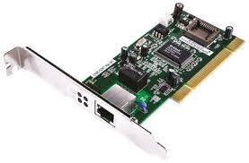
Common Network Connectivity Devices
Network Interface Controller (NIC)
A hardware that connects computers to a network
Every NIC has a unique MAC address
Notes:
A network interface controller (NIC, also known as a network interface card, network adapter, LAN adapter or physical network interface, and by similar terms) is a computer hardware component that connects a computer to a computer network.
Early network interface controllers were commonly implemented on expansion cards that plugged into a computer bus. The low cost and ubiquity of the Ethernet standard means that most newer computers have a network interface built into the motherboard.

Slide 30
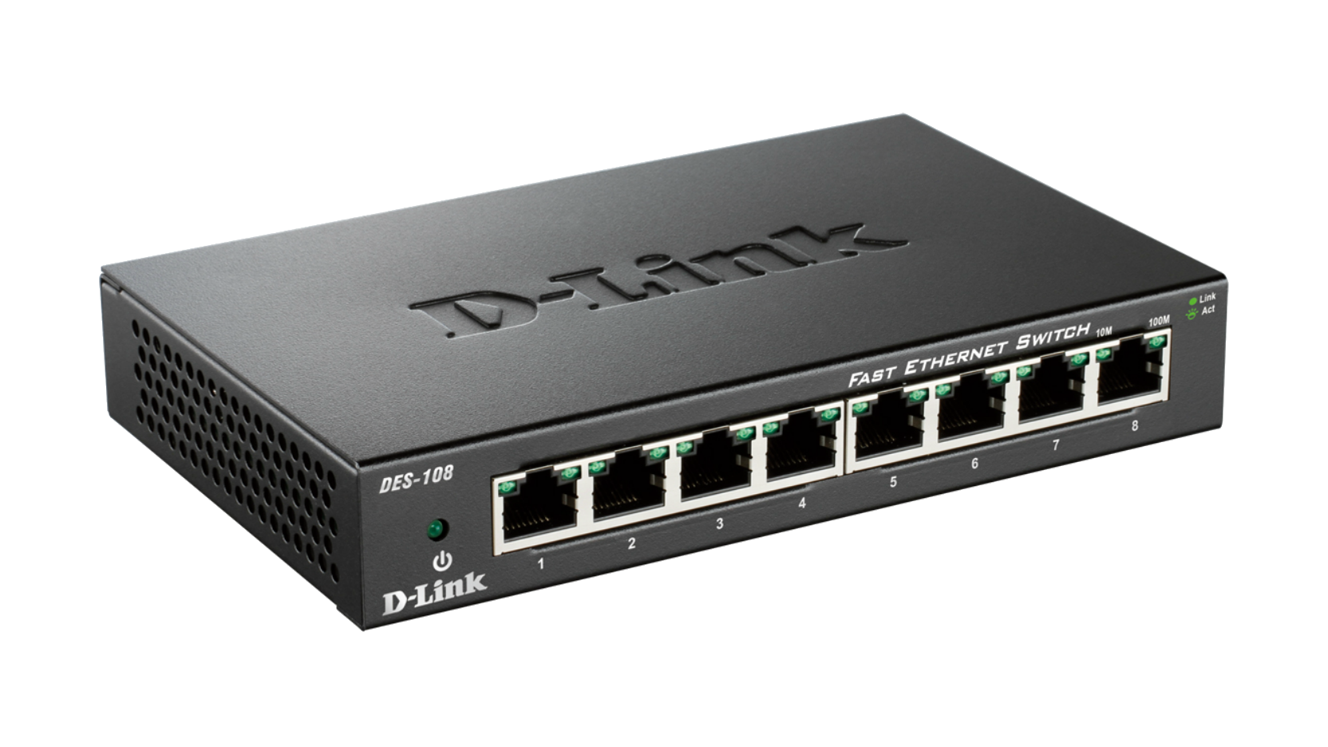
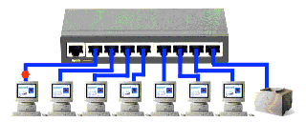
Common Network Connectivity Devices
Hub
Broadcasts data to every computer connected to it
Suitable for small LANs
Not secure because all traffic can be captured
No routing capability
Creates a collision domain
Half-duplex
Notes:
A network hub is a node that broadcasts data to every computer or Ethernet-based device connected to it. A hub is less sophisticated than a switch, the latter of which can isolate data transmissions to specific devices.
Network hubs are best suited for small, simple local area network (LAN) environments. Hubs cannot provide routing capabilities or other advanced network services. Because they operate by forwarding packets across all ports indiscriminately, network hubs are sometimes referred to as "dumb switches."
Today, hubs are considered obsolete and switches are commonly used instead. Hubs have numerous disadvantages. They are not aware of the traffic that passes through them. They create only one large collision domain. A hub typically operates in half-duplex. There is also a security issue with hubs since the traffic is forwarded to all ports (except the source port), which makes it possible to capture all traffic on a network with a network sniffer!

Slide 31
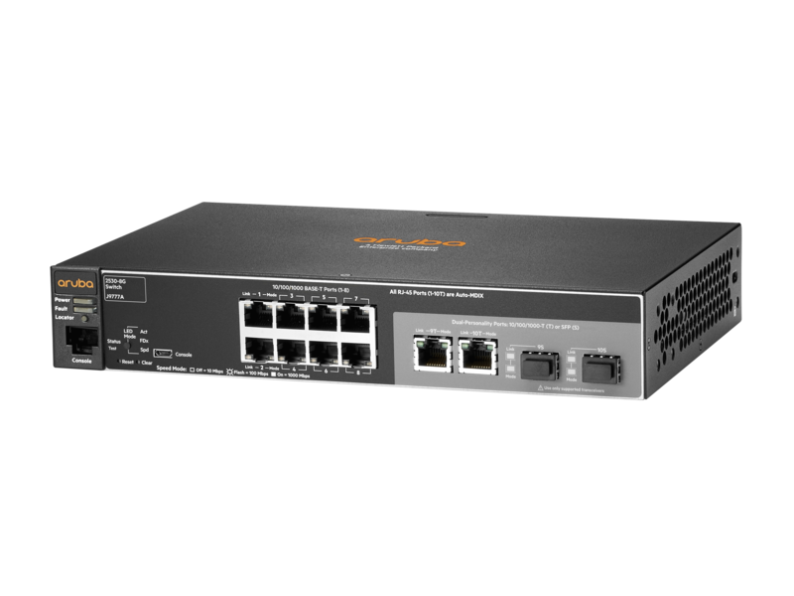
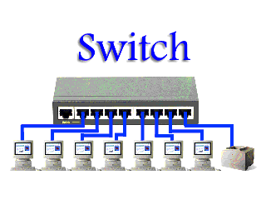
Common Network Connectivity Devices
Switch
Connects multiple hosts together (like Hub)
Works on Data Link Layer (Layer 2) (unlike Hub)
Can inspect received traffic and forwards only to recipient(s) (unlike Hub)
Each port on a Switch is a separate collision
Full-duplex (unlike Hub)
Notes:
Like hubs, a switch is used to connect multiple hosts together, but it has many advantages over a hub. A switch is an OSI Layer 2 device, which means that it can inspect received traffic and make forwarding decisions. Each port on a switch is a separate collision domain and can run in a full-duplex mode.

Slide 32
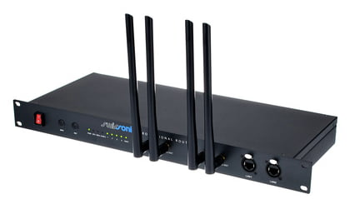
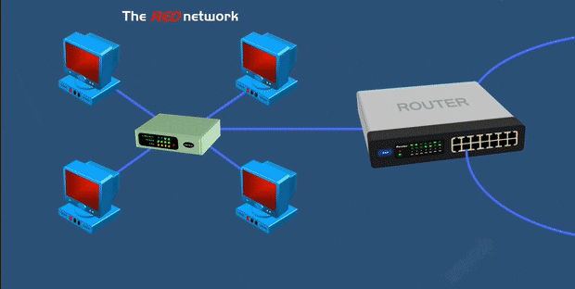
Common Network Connectivity Devices
Router
Connects multiple segments together
Uses IP addresses to make decisions about the best way to get the data to its destination
Works on Network Layer (Layer 3)
Combination of hardware and software
Notes:
A router is a network device used to connect many, sometimes disparate, network segments together, combining them into what we call an internetwork. A well-configured router can make intelligent decisions about the best way to get network data to its destination. It gathers the information it needs to make these decisions based on a network’s particular performance data. As routers use IP addresses to make forwarding decisions, they are considered Layer 3 devices.

Slide 33
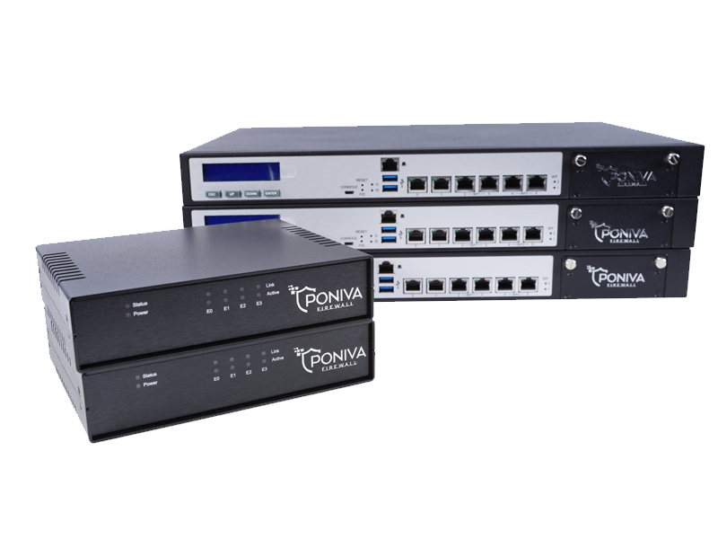
Common Network Connectivity Devices
Firewall
Prevents unauthorized access to or from a private network
Protects a network's data and resources from outside access and threats
Usually placed at the end point of a network
Either a hardware (black
box) or a software
Notes:
Firewalls prevent unauthorized access to or from a private network. Firewalls can enhance the security of computers in a LAN.
Firewalls are used to protect a network's data and resources from outside access and threats. A Firewall is used as a barrier between an internal network of an organization and another network (may be public internet or another network of the same organization).
Since the primary function of a Firewall is to protect a network's data and resources from outside threats, they are usually placed at the end point of a network.
Firewalls can either be software or hardware, though it’s best to have both. A software firewall is a program installed on each computer and regulates traffic through port numbers and applications, while a physical firewall is a piece of equipment installed between your network and gateway.

Slide 34
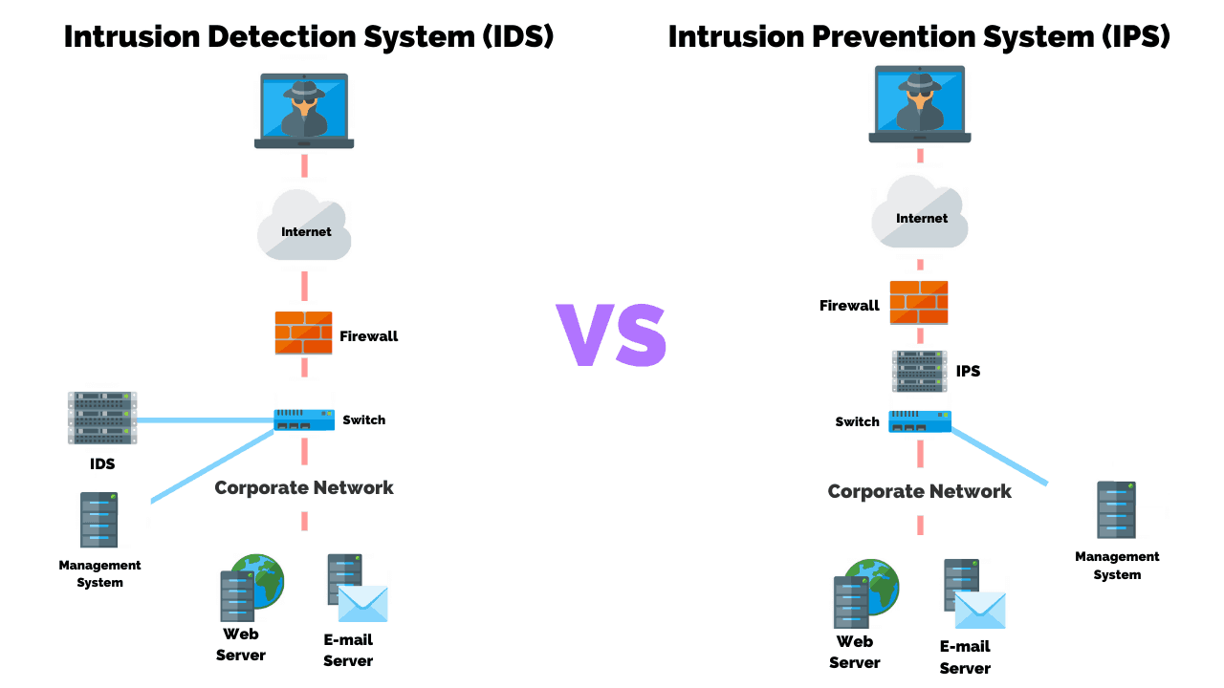
Common Network Connectivity Devices
IDS/IPS
Intrusion Detection System (IDS) monitors traffic and report malicious activities
Intrusion Prevention System (IPS) stops threats in real-time as they occur
Notes:
Intrusion detection systems (IDSs) and intrusion prevention systems (IPSs) are very important in today’s networks. They are network security appliances that monitor networks and packets for malicious activity. An IDS is considered monitor mode and just records and tells you about problems, whereas an IPS can work in real-time to stop threats as they occur. The main difference between them is that an IPS works inline to actively prevent and block intrusions that are detected based on the rules you set up. IPSs can send an alarm, create correlation rules and remediation, drop malicious packets, provide malware protection, and reset the connection of offending source hosts.

Slide 35
Other Specialized Devices
2

Slide 36
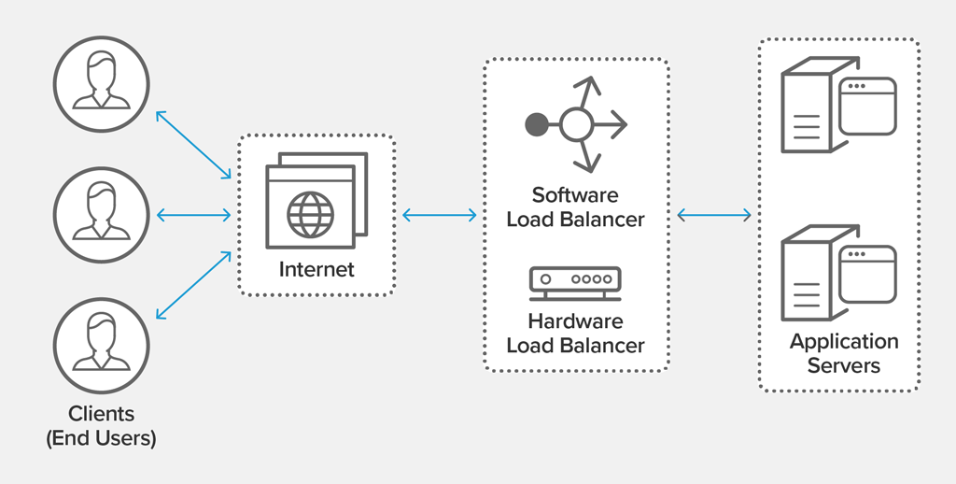
Other Specialized Devices
Load Balancer
Distributes client requests or network load efficiently across multiple servers
Ensures high availability and reliability by sending requests only to servers that are online
Provides the flexibility to
add or subtract servers
as demand dictates
Notes:
An average router just sends incoming packets to their specified, correlative IP address on the network, but a load balancer can actually send incoming packets to multiple machines hidden behind one IP address.
A load balancer acts as the “traffic cop” sitting in front of your servers and routing client requests across all servers capable of fulfilling those requests in a manner that maximizes speed and capacity utilization and ensures that no one server is overworked, which could degrade performance. If a single server goes down, the load balancer redirects traffic to the remaining online servers. When a new server is added to the server group, the load balancer automatically starts to send requests to it.
In this manner, a load balancer performs the following functions:
Distributes client requests or network load efficiently across multiple servers
Ensures high availability and reliability by sending requests only to servers that are online
Provides the flexibility to add or subtract servers as demand dictates

Slide 37
Other Specialized Devices
Domain Name Service (DNS) Server
Finds the IP addresses of hostnames
Computers use IP addresses, humans use names
Easier to remember www.clarusway.com than 13.35.253.82
There are thousands of DNS servers
Managed and controlled by The Internet Assigned Numbers Authority (IANA)
IANA is operated by the Internet Corporation for Assigned Names and Numbers (ICANN)
Notes:
The networks which are running on TCP/IP protocol suite use IP Address (IPv4 Address or IPv6 Address), as the addressing mechanism. IP address (IPv4 Address or IPv6 Address) uniquely identifies a TCP/IP device in the network. However, it is difficult for the humans to remember IP Addresses for all the computers they want to communicate. Think about difficulty in remembering the IP Addresses of 1000s of web sites we use, if we do not have the option to use their names. Humans prefer to use names instead of IP Addresses. Hence we need a system to map human readable names to corresponding IP Addresses.
The global public Domain Name System (DNS) has a distributed architecture, serving from multiple DNS servers in multiple locations. This helps in load balancing (decreasing the workload on DNS servers) and redundancy (prevents single point of failure).
The Internet Assigned Numbers Authority (IANA) manages and controls the public Internet DNS infrastructure. The Internet Assigned Numbers Authority (IANA) is operated by the Internet Corporation for Assigned Names and Numbers (ICANN).

Slide 38
Other Specialized Devices
Domain Name Service (DNS) Server
.com A commercial organization
.edu An educational establishment, such as a university
.gov A branch of the U.S. government
.int An international organization, such as NATO or the United Nations
.mil A branch of the U.S. military
.net A network organization
.org A nonprofit organization
Some DNS names end with country name like:
.jp (Japan) .ca (Canada) .uk (Great Britain)
Notes:
We said that the DNS has a hierarchical naming system.
On the Internet, domains are arranged in a hierarchical tree structure. The following list includes some of the top-level domains currently in use:
.com A commercial organization. Most companies end up as part of this domain.
.edu An educational establishment, such as a university.
.gov A branch of the U.S. government.
.int An international organization, such as NATO or the United Nations.
.mil A branch of the U.S. military.
.net A network organization.
.org A nonprofit organization.
In other parts of the world, the final part of a domain name represents the country in which the server is located (.ca for Canada, .jp for Japan, .uk for Great Britain, and .ru for Russia, for example). Over 130 countries are represented on the Internet.

Slide 39
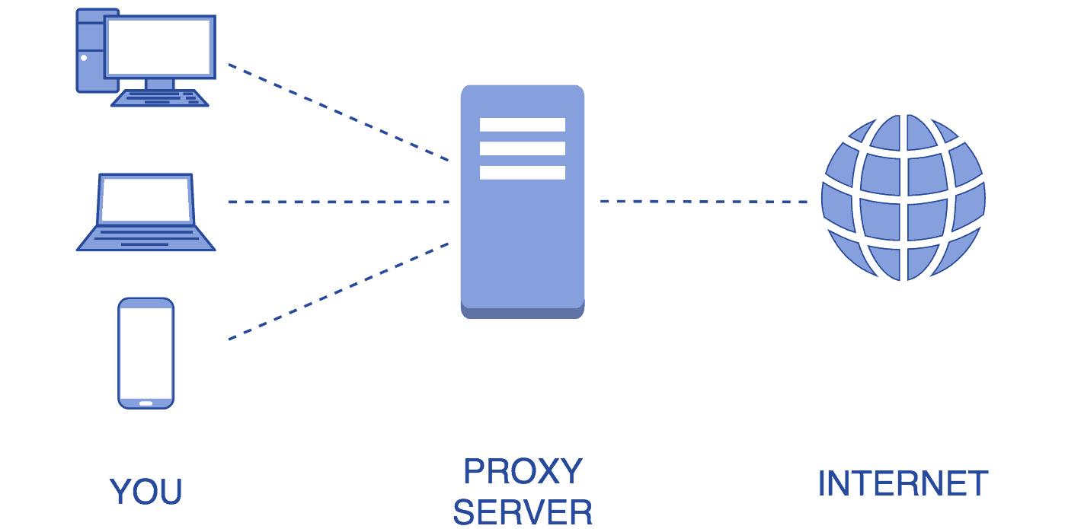
Other Specialized Devices
Proxy Server
Acts as a gateway between you and the internet
Acts as a firewall and web filter
Provides shared network connections
Caches data to speed up common requests
Provides privacy
Notes:
A proxy server acts as a gateway between you and the internet. It’s an intermediary server separating end users from the websites they browse. Proxy servers provide varying levels of functionality, security, and privacy depending on your use case, needs, or company policy.
If you’re using a proxy server, internet traffic flows through the proxy server on its way to the address you requested. The request then comes back through that same proxy server (there are exceptions to this rule), and then the proxy server forwards the data received from the website to you.
If that’s all it does, why bother with a proxy server? Why not just go straight from to the website and back?
Modern proxy servers do much more than forwarding web requests, all in the name of data security and network performance. Proxy servers act as a firewall and web filter, provide shared network connections, and cache data to speed up common requests. A good proxy server keeps users and the internal network protected from the bad stuff that lives out in the wild internet. Lastly, proxy servers can provide a high level of privacy.
How Does a Proxy Server Operate?
Every computer on the internet needs to have a unique Internet Protocol (IP) Address.
A proxy server is basically a computer on the internet with its own IP address that your computer knows. When you send a web request, your request goes to the proxy server first. The proxy server then makes your web request on your behalf, collects the response from the web server, and forwards you the web page data so you can see the page in your browser.
When the proxy server forwards your web requests, it can make changes to the data you send and still get you the information that you expect to see. A proxy server can change your IP address, so the web server doesn’t know exactly where you are in the world. It can encrypt your data, so your data is unreadable in transit. And lastly, a proxy server can block access to certain web pages, based on IP address.

Slide 40
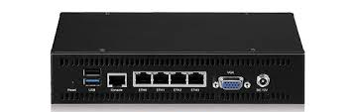
Other Specialized Devices
Encryption Devices
Allows you to create secure connections over insecure channels
Sometimes called encryption gateway
Notes:
Network encryptors secure data travelling across today’s highly distributed computer network topologies. To protect data in motion – in real-time – requires a crypto management with extremely high performance and strong algorithms in order to avoid latency and synchronization problems.
Encryption allows you to create secure connections over insecure channels. Encrypting your network traffic provides two useful guarantees: privacy and authentication.
There are dedicated appliances that can perform encryption as well. The advantage of using these devices is that they normally provide more choice of encryption methods and stronger encryption options. They also offload the process from other devices like routers and servers, which is a good thing since the encryption/decryption process is very processor-intensive and interferes with other functions that those routers and servers might be performing.

Slide 41
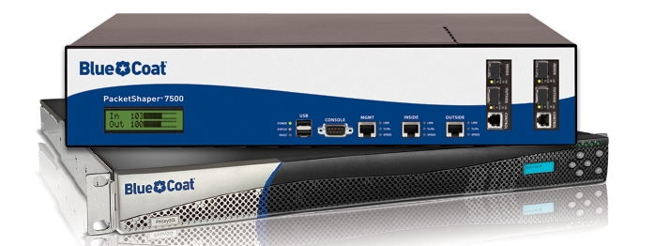
Other Specialized Devices
Packet Shaping (Traffic Shaping)
Traffic shaping (or packet shaping) is a congestion management method that regulates network data transfer by delaying the flow of less important or less desired packets.
Used to optimize network performance by prioritizing certain traffic flows and ensuring the traffic rate doesn't exceed the bandwidth limit.
Notes:
Traffic shaping, also known as packet shaping, is a congestion management method that regulates network data transfer by delaying the flow of less important or less desired packets. It is used to optimize network performance by prioritizing certain traffic flows and ensuring the traffic rate doesn't exceed the bandwidth limit.
Regulating the flow of packets into a network is known as data transfer throttling. Regulation of the flow of packets out of a network is known as rate limiting.
In addition to bandwidth, three major factors affect the quality of a network: latency, jitter and loss.
Traffic shaping attempts to prevent delay, jitter and loss by controlling the burst size and using a leaky bucket algorithm to smooth the output rate over at least eight time intervals. If traffic is arriving at a rate lower than the configured rate, then it will be forwarded normally. If traffic arrives faster than the configured rate, then it will be delayed and held in a buffer until it can be sent without going over the limit.

Slide 42
Other Specialized Devices
Packet Shaping (Traffic Shaping)
Common uses of traffic shaping include:
Time-sensitive data may be given priority over traffic that can be delayed briefly
In a corporate environment, business-related traffic may be given priority over other traffic
A large ISP may shape traffic based on customer priority
An ISP may limit maximum bandwidth consumption for certain applications to reduce costs and create the capacity to take on additional subscribers
Notes:
Traffic shaping, also known as packet shaping, is a congestion management method that regulates network data transfer by delaying the flow of less important or less desired packets. It is used to optimize network performance by prioritizing certain traffic flows and ensuring the traffic rate doesn't exceed the bandwidth limit.
Regulating the flow of packets into a network is known as data transfer throttling. Regulation of the flow of packets out of a network is known as rate limiting.
In addition to bandwidth, three major factors affect the quality of a network: latency, jitter and loss.
Traffic shaping attempts to prevent delay, jitter and loss by controlling the burst size and using a leaky bucket algorithm to smooth the output rate over at least eight time intervals. If traffic is arriving at a rate lower than the configured rate, then it will be forwarded normally. If traffic arrives faster than the configured rate, then it will be delayed and held in a buffer until it can be sent without going over the limit.

Slide 43
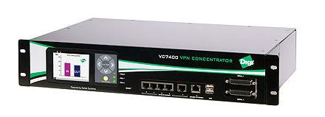
Other Specialized Devices
VPN Concentrator
Provides secure creation of VPN connections
A type of router device
It can:
Establish and configure tunnels
Authenticate users
Assign tunnel/IP addresses to users
Encrypt and decrypt data
Ensure end-to-end delivery of data
Notes:
A VPN concentrator is a type of networking device that provides secure creation of VPN connections and delivery of messages between VPN nodes.
It is a type of router device, built specifically for creating and managing VPN communication infrastructures.
A VPN concentrator primarily adds the capabilities of a VPN router by adding advanced data and network security to the communications. It has the ability to create and manage a large quantity of VPN tunnels.
A VPN concentrator is typically used for creating site-to-site VPN architectures. It can:
Establish and configure tunnels
Authenticate users
Assign tunnel/IP addresses to users
Encrypt and decrypt data
Ensure end-to-end delivery of data

Slide 44
Introduction to TCP/IP

Slide 45
Table of Contents
A Brief History of TCP/IP
TCP/IP and the DoD Model
The Process/Application Layer Protocols
The Host-to-Host/Transport Layer Protocols
The Internet Layer Protocols

Slide 46
A Brief History of TCP/IP
1

Slide 47
A Brief History of TCP/IP
TCP/IP (Transmission Control Protocol/Internet Protocol) is a set of network protocols (Protocol Suite) that enable communication between computers
TCP first came on the scene in 1974
Divided into two distinct protocols, TCP and IP in 1978
Became the officials means of data transport for ARPANet in 1983
Mostly developed in UC Berkeley simultaneously with Berkeley version of UNIX (BSD)
Notes:
TCP/IP is a set of network protocols (Protocol Suite) that enable communication between computers. Network protocols are rules or standards that govern network communications. If two devices in a network need to communicate together, they need to use common set of network protocols. This can be compared with how humans speak. A French person cannot communicate with a Vietnamese person (without help from a translator) since they speak different languages.
You can select from different network protocols to use in your network, but TCP/IP is the industry standard. Almost all Operating Systems now support TCP/IP. Internet is working on TCP/IP. TCP/IP is known as "the language of the Internet". If you want your computer and computer live devices to work on the Internet, you have to use TCP/IP protocol suite.
The predecessor of today’s Internet was ARPAnet, created by the Advanced Research Projects Agency (ARPA) and launched in 1969 during "Cold War".
The protocol used on the ARPAnet was called Network Control Protocol (NCP). As the ARPAnet grew, however, a new protocol was needed because NCP was not able to fulfil all the needs of a larger network. In 1974 Vint Cerf and Bob Kahn, published a paper “A Protocol for Packet Network Interconnection.” This paper describes the Transmission Control Protocol (TCP), which eventually replaced NCP.
ARPAnet ceased to exist in 1990. The Internet has since grown from ARPAnet’s roots, and TCP/IP has evolved to meet the changing requirements of the Internet.

Slide 48
TCP/IP and the DoD Model
2

Slide 49
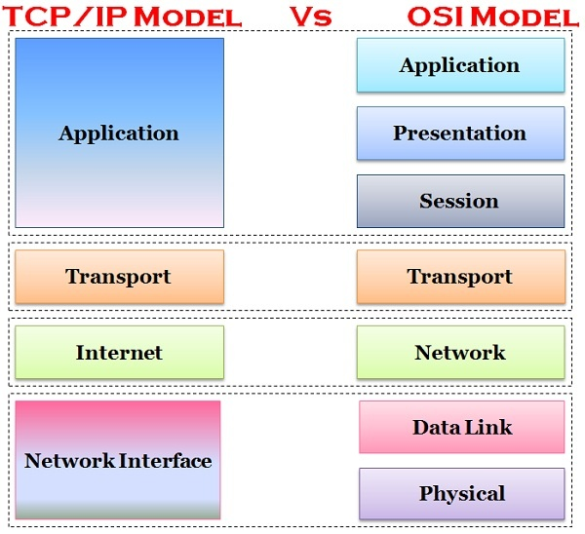
TCP/IP (DoD) and the OSI Model
The DoD (Department of Defense) created TCP/IP to ensure and preserve data integrity
The DoD model is a condensed version of the OSI model

Slide 50
TCP/IP and the DoD Model
Process/Application layer
Enables applications to communicate with each other.
Provides access to the services that operate at the lower layers of the DoD model.
It contains a protocol that implements user-level functions such as mail delivery, file transfer, and remote login.
Includes all higher-level protocols: DNS, HTTP, Telnet, SSH, FTP, SNMP, DHCP, etc.
DNS: Domain Name Service
HTTP: Hyper-text Transfer Protocol
SSH: Secure Shell
FTP: File Transfer Protocol
SNMP: Simple Network Management Protocol
DHCP: Dynamic Host Configuration Protocol
Notes:
The Application layer of the DoD model is equivalent to the upper three layers of the OSI model, i.e., Session layer, Presentation layer, and Application layer. The Process/Application layer of the DoD model provides the following capabilities:
Enable applications to communicate with each other.
Provides access to the services that operate at the lower layers of the DoD model.
It contains a protocol that implements user-level functions such as mail delivery, file transfer, and remote login.
Application layer includes all the higher-level protocols like DNS (Domain Naming System), HTTP (Hypertext Transfer Protocol), Telnet, SSH, FTP (File Transfer Protocol), TFTP (Trivial File Transfer Protocol), SNMP (Simple Network Management Protocol), SMTP (Simple Mail Transfer Protocol) , DHCP (Dynamic Host Configuration Protocol), X Windows, RDP (Remote Desktop Protocol) etc.

Slide 51
TCP/IP and the DoD Model
Host-to-Host Layer (Transport Layer)
Permits devices on the source and destination to carry on a conversation
Defines the level of service and status of the connection used when transporting data
Main protocols are TCP and UDP
TCP: Transmission Control Protocol
UDP: User Datagram Protocol
Notes:
Host-to-Host Layer(or Transport Layer) is the third layer of the four-layer TCP/IP model. The position of the Transport layer is between Application layer and Internet layer. The purpose of Transport layer is to permit devices on the source and destination hosts to carry on a conversation. Transport layer defines the level of service and status of the connection used when transporting data.
The main protocols included at Transport layer are TCP (Transmission Control Protocol) and UDP (User Datagram Protocol).

Slide 52
TCP/IP and the DoD Model
Internet Layer
Packs data into data packets known as IP datagrams
Responsible for routing of IP datagrams
Main protocols are IP, ICMP, ARP, RARP, and IGMP
IP: Internet Protocol
ICMP: Internet Control Message Protocol
ARP: Address Resolution Protocol
RARP: Reverse Address Resolution Protocol
IGMP: Internet Group Message Protocol
Notes:
Internet Layer is the second layer of the four-layer TCP/IP model. The position of Internet layer is between Network Access Layer and Transport layer. Internet layer pack data into data packets known as IP datagrams, which contain source and destination address (logical address or IP address) information that is used to forward the datagrams between hosts and across networks. The Internet layer is also responsible for routing of IP datagrams.
Packet switching network depends upon a connectionless internetwork layer. This layer is known as Internet layer. Its job is to allow hosts to insert packets into any network and have them to deliver independently to the destination. At the destination side data packets may appear in a different order than they were sent. It is the job of the higher layers to rearrange them in order to deliver them to proper network applications operating at the Application layer.
The main protocols included at Internet layer are IP (Internet Protocol), ICMP (Internet Control Message Protocol), ARP (Address Resolution Protocol), RARP (Reverse Address Resolution Protocol) and IGMP (Internet Group Management Protocol).

Slide 53
TCP/IP and the DoD Model
Network Access Layer
Defines details of how data is physically sent through the network
Main protocols are Ethernet, Token Ring, FDDI, X.25, and Frame Relay
FDDI: Fiber Distributed Data Interface
Notes:
Network Access Layer is the first layer of the four-layer TCP/IP model. Network Access Layer defines details of how data is physically sent through the network, including how bits are electrically or optically signaled by hardware devices that interface directly with a network medium, such as coaxial cable, optical fiber, or twisted pair copper wire.
The protocols included in Network Access Layer are Ethernet, Token Ring, FDDI, X.25, Frame Relay etc.

Slide 54
The Process/Application Layer Protocols
3

Slide 55
The Process/Application Layer Protocols
Telnet (TCP 23): Allows a user on a remote client machine to access the resources of another machine.
SSH (TCP 22): Secure Shell Protocol sets up a secure session that’s similar to Telnet over a standard TCP/IP connection and is employed for doing things like logging into systems, running programs on remote systems and moving file from one system to another system.
Notes:
Telnet (TCP 23): Telnet allows a user on a remote client machine, called the Telnet Client, to access the resources of another machine. The drawback of Telnet is that there are no encryption techniques available within the Telnet Protocols, so everything must be sent in the cleartext.

Slide 56
The Process/Application Layer Protocols
FTP (TCP 20, 21): File Transfer Protocol lets us transfer files between any two machines. FTP functions are limited to listing and manipulating directories, typing file contents, and copying files between hosts.
SFTP (TCP 22): Same as FTP but Secure FTP uses an encrypted connection through an SSH session, which encrypts the connection.
TFTP (UDP 69): Trivial FTP is the stripped-down, stock version of FTP. TFTP is fast and so easy to use. It can only send and receive files.
Notes:
Telnet (TCP 23): Telnet allows a user on a remote client machine, called the Telnet Client, to access the resources of another machine. The drawback of Telnet is that there are no encryption techniques available within the Telnet Protocols, so everything must be sent in the cleartext.
FTP (TCP 20, 21): File Transfer Protocol lets us transfer files, and it can accomplish this between any two machines using it. FTP allows access to both directories and files and can accomplish certain types of directory operations, such as relocating into different ones. FTP functions are limited to listing and manipulating directories, typing file contents, and copying files between hosts.
SFTP (TCP 22): Secure File Transfer Protocol is used when you need to transfer files over an encrypted connection. It uses an SSH session, which encrypts the connection, and SSH uses port 22, hence the port 22 is used for SFTP. Apart from the secure part, it’s used just as FTP is—for transferring files between computers on an IP network, such as the Internet.

Slide 57
The Process/Application Layer Protocols
POP (TCP 110): Post Office Protocol gives us a storage facility for incoming mail (the latest version is POP3). A newer standard, IMAP, is being used more and more in place of POP3.
IMAP (TCP 143): Internet Message Access Protocol makes it so you get control over how you download your mail, with it, you also gain some much-needed security. It has some serious authentication features. IMAP4 is the current version.
Notes:
TFTP (UDP 69): Trivial File Transfer Protocol (TFTP) is the stripped-down, stock version of FTP. TFTP is fast and so easy to use. TFTP doesn’t offer the abundance of functions that FTP does because it has no directory-browsing abilities, meaning that it can only send and receive files.
POP (TCP 110): Post Office Protocol gives us a storage facility for incoming mail, and the latest version is called POP3. How this protocol works is when a client device connects to a POP3 server, messages addressed to that client are released for download. It doesn’t allow messages to be downloaded selectively, but once they are, the client-server interaction ends and you can delete and tweak your messages locally at will. A newer standard, IMAP, is being used more and more in place of POP3.
IMAP (TCP 143): Because Internet Message Access Protocol (IMAP) makes it so you get control over how you download your mail, with it, you also gain some much-needed security. It lets you peek at the message header or download just a part of a message. With it, you can choose to store messages on the email server hierarchically and link to documents and user groups, too. IMAP even gives you search commands to use to hunt for messages based on their subject, header, or content. As you can imagine, it has some serious authentication features—it supports the Kerberos authentication scheme that MIT developed. IMAP4 is the current version.

Slide 58
The Process/Application Layer Protocols
RDP (TCP 3389): Remote Desktop Protocol is a proprietary protocol developed by Microsoft. It allows you to connect to another computer and run programs. Windows, and Macs now come with a preinstalled RDP client.
TLS/SSL (TCP 995/465): Both Transport Layer Security and its forerunner, Secure Sockets Layer, are cryptographic protocols that are useful for enabling secure online data-transfer activities like browsing the Web, instant messaging, Internet faxing, and so on.
Notes:
RDP (TCP 3389): Remote Desktop Protocol is a proprietary protocol developed by Microsoft. It allows you to connect to another computer and run programs. RDP operates somewhat like Telnet, except instead of getting a command-line prompt as you do with Telnet, you get the actual graphical user interface (GUI) of the remote computer. Clients exist for most versions of Windows, and Macs now come with a preinstalled RDP client. Microsoft currently calls its official RDP server software Remote Desktop Services. Microsoft’s official client software is currently referred to as Remote Desktop Connection. RDP is an excellent tool for remote clients, allowing them to connect to their work computer from home, for example, and get their email or perform work on other applications without running or installing any of the software on their home computer.
TLS/SSL (TCP 995/465): Both Transport Layer Security and its forerunner, Secure Sockets Layer, are cryptographic protocols that are useful for enabling secure online data-transfer activities like browsing the Web, instant messaging, Internet faxing, and so on. They’re so similar. They both use X.509 certificates and asymmetric cryptography to authenticate to the host they are communicating with and to exchange a key. This key is then used to encrypt data flowing between the hosts. This allows for data/message confidentiality, message integrity, and message authentication.

Slide 59
The Process/Application Layer Protocols
SIP (VoIP) (TCP or UDP 5060/TCP 5061): Session Initiation Protocol is a hugely popular protocol used to construct and deconstruct multimedia communication sessions for many things like voice and video calls, video conferencing, streaming multimedia distribution, instant messaging, presence information, and online games over the Internet.
RTP (VoIP) (UDP 5004/TCP 5005): Real-time Transport Protocol describes a packet-formatting standard for delivering audio and video over the Internet.
Notes:
SIP (VoIP) (TCP or UDP 5060/TCP 5061): Session Initiation Protocol is a hugely popular signaling protocol used to construct and deconstruct multimedia communication sessions for many things like voice and video calls, videoconferencing, streaming multimedia distribution, instant messaging, presence information, and online games over the Internet.
RTP (VoIP) (UDP 5004/TCP 5005): Real-time Transport Protocol describes a packet-formatting standard for delivering audio and video over the Internet. Although initially designed as a multicast protocol, it’s now used for unicast applications, too. It’s commonly employed for streaming media, videoconferencing, and push-to-talk systems—all things that make it a de facto standard in Voice over IP (VoIP) industries.

Slide 60
The Process/Application Layer Protocols
MGCP (Multimedia) (TCP 2427/2727): Media Gateway Control Protocol is a standard protocol for handling the signaling and session management needed during a multimedia conference.
H.323 (Video) (TCP 1720): H.323 is a protocol that provides a standard for video on an IP network that defines how real-time audio, video, and data information is transmitted.
Notes:
MGCP (Multimedia) (TCP 2427/2727): Media Gateway Control Protocol is a standard protocol for handling the signaling and session management needed during a multimedia conference. The protocol defines a means of communication between a media gateway, which converts data from the format required for a circuit-switched network to that required for a packet-switched network, and the media gateway controller. MGCP can be used to set up, maintain, and terminate calls between multiple endpoints.
H.323 (Video) (TCP 1720): H.323 is a protocol that provides a standard for video on an IP network that defines how real-time audio, video, and data information is transmitted. This standard provides signaling, multimedia, and bandwidth control mechanisms. H.323 uses the RTP standard for communication.
SSH (TCP 22): Secure Shell Protocol sets up a secure session that’s similar to Telnet over a standard TCP/IP connection and is employed for doing things like logging into systems, running programs on remote systems and moving file from one system to another system. And it does all this while maintaining an encrypted connection.

Slide 61
The Process/Application Layer Protocols
SNMP (UDP 161/TCP 25): Simple Network Management Protocol collects and manipulates valuable network information. It gathers data by polling the devices on the network from a management station at fixed or random intervals, requiring them to disclose certain information. This protocol can also stand as a watchdog over the network, quickly notifying managers of any sudden turn of events. Besides, SNMP can help simplify the process of setting up a network as well as the administration of your entire internetwork.
Notes:
SNMP (UDP 161/TCP 25): Simple Network Management Protocol collects and manipulates valuable network information. It gathers data by polling the devices on the network from a management station at fixed or random intervals, requiring them to disclose certain information. When all is well, SNMP receives something called a baseline—a report delimiting the operational traits of a healthy network. This protocol can also stand as a watchdog over the network, quickly notifying managers of any sudden turn of events. The network watchdogs are called agents, and when aberrations occur, agents send an alert called a trap to the management station. Besides, SNMP can help simplify the process of setting up a network as well as the administration of your entire internetwork.

Slide 62
The Process/Application Layer Protocols
HTTP (TCP 80): Hypertext Transfer Protocol is used to manage communications between web browsers and web servers.
HTTPS (TCP 443): HTTP Secure uses the Secure Socket Layer (SSL). It is the secure version of the HTTP.
NTP (UDP 123): Network Time Protocol is used to synchronize the clocks on our computer to one standard time source. This protocol works by synchronizing devices to ensure that all the computers on a given network agree on the time.
Notes:
HTTP (TCP 80): Hypertext Transfer Protocol is used to manage communications between web browsers and web servers and opens the right resources when you click a link, wherever that resource may reside.
HTTPS (TCP 4743): Hypertext Transfer Protocol Secure is also known as a secure Hypertext Transfer Protocol. It uses the Secure Socket Layer (SSL). It is the secure version of the HTTP that arms us with a whole bunch of security tools for keeping transactions between web browsers and servers secure. It is what our browser needs to fill out forms, sign in, authenticate, and encrypt an HTTP message when we do things like making an online reservation, accessing online banking, or buying something online.
NTP (UDP 123): Network Time Protocol is used to synchronize the clocks on our computer to one standard time source. This protocol works by synchronizing devices to ensure that all the computers on a given network agree on the time.

Slide 63
The Process/Application Layer Protocols
LDAP (TCP 389): Lightweight Directory Access Protocol standardizes how you access directories.
IGMP: Internet Group Management Protocol is the TCP/IP protocol used for managing IP multicast sessions. It accomplishes this by sending out unique IGMP messages over the network to reveal the multicast-group landscape and to find out which hosts belong to which multicast group. IGMP works at the Network layer and doesn’t use port numbers.
Notes:
LDAP (TCP 389): If you’re the system administrator of any decent-sized network, odds are you have a type of directory in place that keeps track of all your network resources, such as devices and users. You can do this through the Lightweight Directory Access Protocol. This protocol standardizes how you access directories, and Introducing TCP/IP 185 its first and second inceptions are described in RFCs 1487 and 1777, respectively. There were a few glitches in those two earlier versions, so a third version—the one most commonly used today—was created to address those issues and is described in RFC 3377.
IGMP: Internet Group Management Protocol is the TCP/IP protocol used for managing IP multicast sessions. It accomplishes this by sending out unique IGMP messages over the network to reveal the multicast-group landscape and to find out which hosts belong to which multicast group. The host machines in an IP network also use IGMP messages to become members of a group and to quit the group, too. IGMP messages come in seriously handy for tracking group memberships as well as active multicast streams. IGMP works at the Network layer and doesn’t use port numbers.

Slide 64
The Process/Application Layer Protocols
DHCP (UDP 67/68): Dynamic Host Configuration Protocol assigns IP Address to hosts. It allows for easier administration and works well in small to very large network environments. Many types of hardware can be used as a DHCP Server, including a Cisco Router. There is a lot of information a DHCP server can provide to a host when the host is requesting an IP address from DHCP Server like
IP Address
Subnet Mask
Domain Name
Default Gateways
DNS Server Address
Notes:
DHCP (UDP 67/68): Dynamic Host Configuration Protocol assigns IP Address to hosts. It allows for easier administration and works well in small to very large network environments. Many types of hardware can be used as a DHCP Server, including a Cisco Router. There is a lot of information a DHCP server can provide to a host when the host is requesting an IP address from DHCP Server, here is the list of some common types of information a DHCP server can provide:
IP Address
Subnet Mask
Domain Name
Default Gateways
DNS Server Address

Slide 65
The Transport Layer Protocols
4

Slide 66
The Transport Layer Protocols
TCP and UDP are the main protocols for Transport Layer
TCP is full-duplex, connection-oriented, reliable and accurate protocol
In order to send information, TCP establishes a connection with the receiving host (connection-oriented)
TCP takes information and breaks it into segments
TCP sends this segments in the order that application intended
After segments are sent TCP waits for the acknowledgement for each segment
Retransmits the segments that aren’t acknowledged (reliable)
Notes:
The main purpose of the Host-to-Host (or Transport) layer is to shield the upper-layer applications from the complexities of the network. This layer says to the upper layer, “Just give me your data stream, with any instructions, and I’ll begin the process of getting your information ready to send.”
The followings are the two protocols at this layer:
Transmission Control Protocol (TCP)
User Datagram Protocol (UDP)
Transmission Control Protocol (TCP) takes large blocks of information from an application and breaks them into segments. It numbers and sequences each segment so that the destination’s TCP process can put the segments back into the order the application intended. After these segments are sent, TCP (on the transmitting host) waits for an acknowledgment from the receiving end’s TCP process, retransmitting those segments that aren’t acknowledged.
Remember that in reliable transport operation, a device that wants to transmit sets up a connection-oriented communication with a remote device by creating a session. The transmitting device first establishes a connection-oriented session with its peer system; that session is called a call setup or a three-way handshake. Data is then transferred, and when the transfer is complete, a call termination takes place to tear down the virtual circuit.
TCP is a full-duplex, connection-oriented, reliable, and accurate protocol, but establishing all these terms and conditions, in addition to error checking, is no small task. TCP is very complicated and costly in terms of network overhead.

Slide 67
The Transport Layer Protocols
UDP uses less bandwidth compared to TCP
UDP transports data much faster than TCP
UDP doesn’t care the order of the segments
UDP doesn’t care if the segment is received by the recipient (no acknowledgement) (not reliable)
UDP doesn’t establish a connection with the receiver (connectionless protocol)
Mostly used while speed is more important than reliability (like video teleconferencing or SNMP)
Notes:
If to compare User Datagram Protocol (UDP) with TCP, the former is basically the scaled-down economy model that’s sometimes referred to as a thin protocol. A thin protocol doesn’t take up much bandwidth on a network. UDP doesn’t offer all the advantages of TCP either, but it does do a fabulous job of transporting information that doesn’t require reliable delivery—and it does so using far fewer network resources.
There are some situations in which it would definitely be wise for developers to opt for UDP rather than TCP. Remember the watchdog SNMP up there at the Process/Application layer. SNMP monitors the network, sending intermittent messages and a fairly steady flow of status updates and alerts, especially when running on a large network. The cost in overhead to establish, maintain, and close a TCP connection for each one of those little messages would reduce what would be an otherwise healthy, efficient network.
Another circumstance calling for UDP over TCP is when reliability is already handled at the Process/Application layer. DNS handles its own reliability issues, making the use of TCP both impractical and redundant. But ultimately, it’s up to the application developer to decide whether to use UDP or TCP, not the user who wants to transfer data faster.
UDP does not sequence the segments and doesn’t care in which order the segments arrive at the destination. But after that, UDP sends the segments off and forgets about them. It doesn’t follow through, check up on them, or even allow for an acknowledgment of safe arrival—complete abandonment. Because of this, it’s referred to as an unreliable protocol. This doesn’t mean that UDP is ineffective, only that it doesn’t handle issues of reliability. Because UDP assumes that the application will use its own reliability method, it doesn’t use any. This gives an application developer a choice when running the IP stack: TCP for reliability or UDP for faster transfers.
Further, UDP doesn’t create a virtual circuit, nor does it contact the destination before delivering information to it. Because of this, it’s also considered a connectionless protocol.

Slide 68
The Transport Layer Protocols
TCP | UDP
Secure | Unsecure
Connection-oriented | Connectionless
Slow | Fast
Guaranteed transmission | No guarantee
Flow control | No flow control
Reliable | Unreliable
Virtual circuit | No virtual circuit
Acknowledgement | No acknowledgement
20 bytes header | 8 bytes header
Notes:
Comparison table of TCP and UDP

Slide 69
The Internet Layer Protocols
5

Slide 70
The Internet Layer Protocols
Main functions: routing and providing a single network interface to upper layers
Main protocols:
Internet Protocol (IP)
Internet Control Message Protocol (ICMP)
Address Resolution Protocol (ARP)
Reverse Address Resolution Protocol (RARP)
Notes:
In the DoD model, there are two main reasons for the Internet layer’s existence: routing and providing a single network interface to the upper layers.
None of the other upper- or lower-layer protocols have any functions relating to routing—that complex and important task belongs entirely to the Internet layer. The Internet layer’s second duty is to provide a single network interface to the upper-layer protocols.
All network depends on IP. And all the other protocols at this layer, as well as all those at the upper layers, use it. Never forget that. All paths through the DoD model go through IP. The following sections describe the protocols at the Internet layer:
Internet Protocol (IP)
Internet Control Message Protocol (ICMP)
Address Resolution Protocol (ARP)
Reverse Address Resolution Protocol (RARP)

Slide 71
The Internet Layer Protocols
Internet Protocol (IP) looks at each packet’s destination address, then, using a routing table, it decides where a packet is to be sent next, choosing the best path.
To find the receiver host, sender has to find out:
On which network is the receiver located?
What is its id?
1
2
Software address
MAC address
Notes:
IP looks at each packet’s destination address. Then, using a routing table, it decides where a packet is to be sent next, choosing the best path. The protocols of the Network Access layer at the bottom of the DoD model don’t possess IP’s enlightened scope of the entire network; they deal only with physical links (local networks).
Identifying devices on networks requires answering these two questions: Which network is it on? And what is its ID on that network? The answer to the first question is the software address, or logical address. The answer to the second question is the hardware address. All hosts on a network have a logical ID called an IP address. This is the software, or logical, address and contains valuable encoded information, greatly simplifying the complex task of routing.
IP receives segments from the Host-to-Host layer and fragments them into packets if necessary. IP then reassembles packets back into segments on the receiving side. Each packet is assigned the IP address of the sender and of the recipient. Each router (Layer 3 device) that receives a packet makes routing decisions based on the packet’s destination IP address.

Slide 72
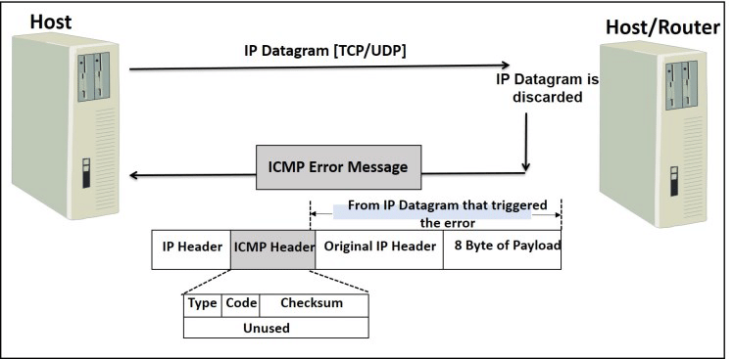
The Internet Layer Protocols
Internet Control Message Protocol (ICMP) is a management protocol and messaging service provider for IP
ICMP messages are sent as IP packets
Common events that ICMP relates to:
Destination unreachable
Buffer full
Hops
Ping and Traceroute use ICMP
Notes:
Internet Control Message Protocol (ICMP) works at the Network layer and is used by IP for many different services. ICMP is a management protocol and messaging service provider for IP. Its messages are carried as IP packets. They are encapsulated within IP datagrams.
They can provide hosts with information about network problems.
The following are some common events and messages that ICMP relates to:
Destination Unreachable - If a router can’t send an IP datagram any further, it uses ICMP to send a message back to the sender, advising it of the situation. For example, the below figure shows that the Ethernet interface of the Lab B router is down.
ICMP error message is sent to the sending host from the remote router.
When Host A sends a packet destined for Host B, the Lab B router will send an ICMP Destination Unreachable message back to the sending device.
Buffer Full - If a router’s memory buffer for receiving incoming datagrams is full, it will use ICMP to send out this message until the congestion abates.
Hops - Each IP datagram is allotted a certain number of routers, called hops, to pass through. If a datagram reaches its limit of hops before arriving at its destination, the last router to receive it deletes it. The executioner router then uses ICMP to send an obituary message, informing the sending machine of the demise of its datagram.
The two most popular programs that use ICMP:
Ping - Ping uses ICMP echo request and reply messages to check the physical and logical connectivity of machines on an internetwork.
Traceroute - Traceroute uses IP packet Time to Live time-outs to discover the path a packet takes as it traverses an internetwork.

Slide 73
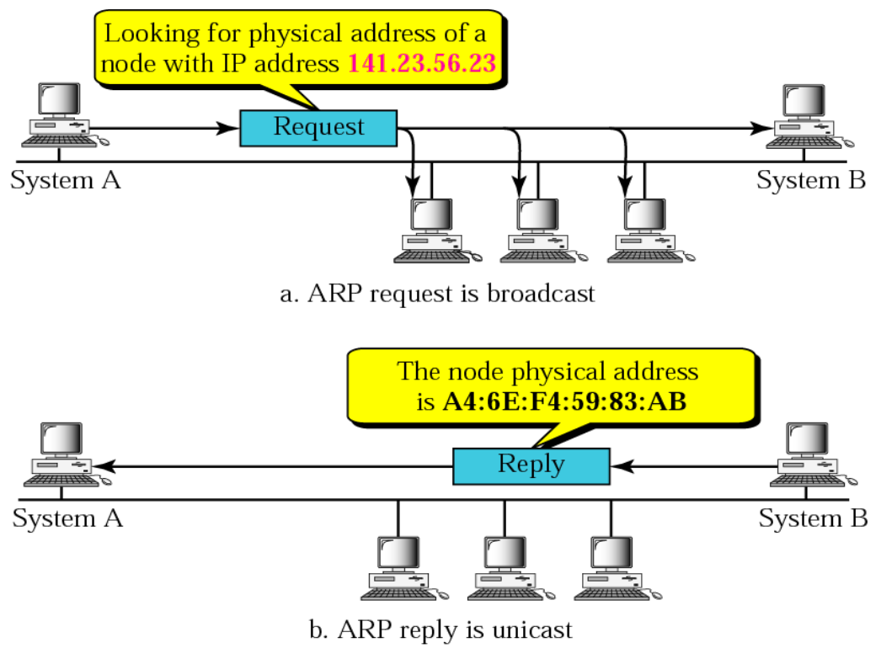
The Internet Layer Protocols
Address Resolution Protocol (ARP) is a procedure for mapping a dynamic IP address to a permanent physical machine address in a LAN
Essentially matches
IPv4 Address
32-bit
MAC Address
48-bit
Notes:
Address Resolution Protocol (ARP) is a procedure for mapping a dynamic Internet Protocol address (IP address) to a permanent physical machine address in a local area network (LAN). The physical machine address is also known as a Media Access Control or MAC address.
The job of the ARP is essentially to translate 32-bit addresses to 48-bit addresses and vice-versa. This is necessary because in IP Version 4 (IPv4), the most common level of Internet Protocol (IP) in use today, an IP address is 32-bits long, but MAC addresses are 48-bits long.
All operating systems in an IPv4 Ethernet network keep an ARP cache. Every time a host requests a MAC address in order to send a packet to another host in the LAN, it checks its ARP cache to see if the IP to MAC address translation already exists. If it does, then a new ARP request is unnecessary. If the translation does not already exist, then the request for network addresses is sent and ARP is performed.
ARP broadcasts a request packet to all the machines on the LAN and asks if any of the machines know they are using that particular IP address. When a machine recognizes the IP address as its own, it sends a reply so ARP can update the cache for future reference and proceed with the communication.

Slide 74
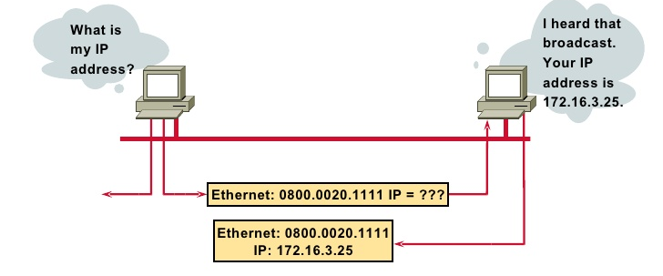
The Internet Layer Protocols
Host machines that don't know their own IP address can use the Reverse ARP (RARP) protocol for discovery
ARP is replaced by Neighbor Discovery Protocol with the use of IPv6
Notes:
Address Resolution Protocol (ARP) is a procedure for mapping a dynamic Internet Protocol address (IP address) to a permanent physical machine address in a local area network (LAN). The physical machine address is also known as a Media Access Control or MAC address.
The job of the ARP is essentially to translate 32-bit addresses to 48-bit addresses and vice-versa. This is necessary because in IP Version 4 (IPv4), the most common level of Internet Protocol (IP) in use today, an IP address is 32-bits long, but MAC addresses are 48-bits long.

Slide 75
Networking
Recap

Slide 76
OSI Model

Slide 77
OSI Model
Nodes must follow rules to communicate
Example: any language - English, Spanish, etc
Rules for networking are divided into 7 layers (OSI Model)
7
Application
6
Presentation
5
Session
4
Transport
3
Network
2
Data Link
1
Physical

Slide 78

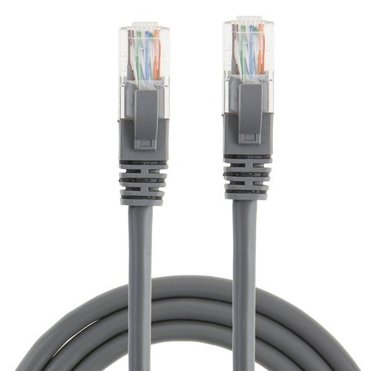
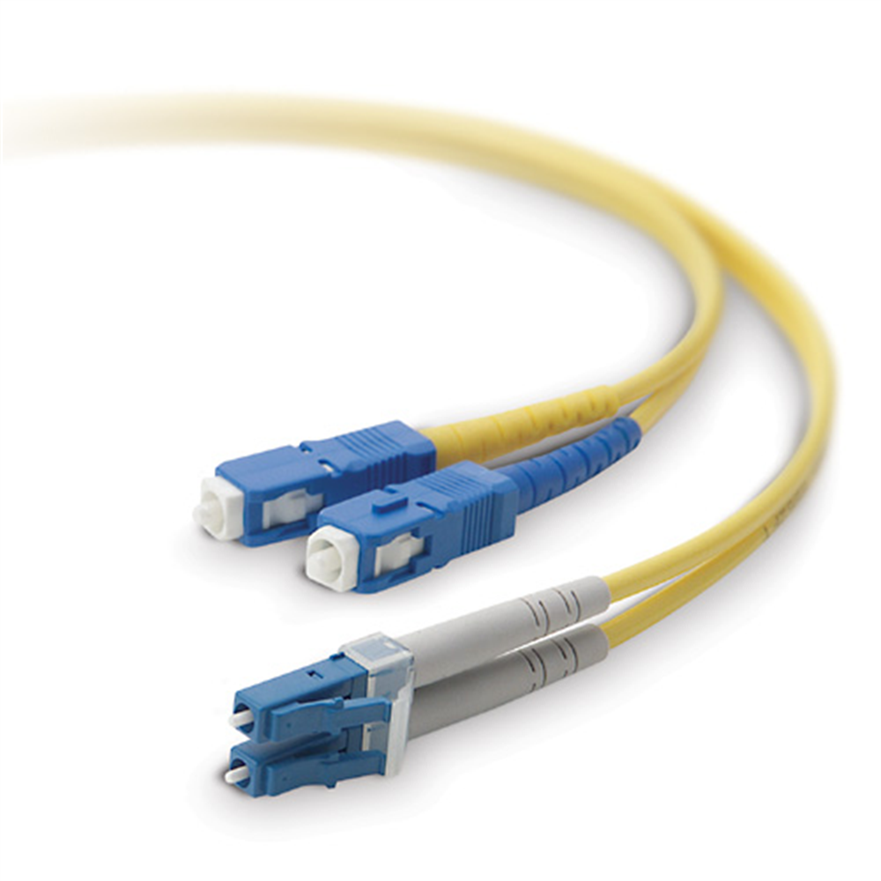

Layer 1 - Physical - Transporting Bits
7
Application
10111011011
6
Presentation
5
Session
4
Transport
Purpose: Transporting Bits
Transmits bits (1’s, 0’s) between nodes
Technologies
Cables, WiFi, Repeaters, Hubs
3
Network
2
Data Link
1
Physical

Slide 79

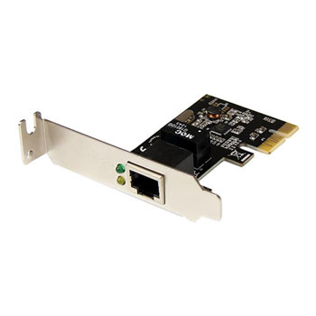
Layer 2 - Data Link - Hop to Hop
7
Application
a1:a1
b2:b2
b3:b3
d5:d5
d6:d6
e7:e7
6
Presentation
router
router
5
Session
4
Transport
Purpose: Hop-to-Hop
Addressing scheme: MAC Address (e.g. 74:56:D9:84:AB:6F)
Often traffic is sent over multiple “hops”
Technologies
Network Interface Card (NIC)
Switch
3
Network
2
Data Link
1
Physical

Slide 80
Layer 3 - Network - End-to-End
7
Application
10.1.1.11
10.3.3.33
6
Presentation
a1:a1
b2:b2
b3:b3
d5:d5
d6:d6
e7:e7
5
Session
router
router
4
Transport
Purpose: End-to-End
Addressing scheme: IP Address
32-bits / 4 Octets each 0-255 (e.g. 192.168.1.20)
Technologies
Routers, Hosts
Anything with an IP
3
Network
2
Data Link
1
Physical

Slide 81



Layer 4 - Transport - Service-to-Service
7
Application
TCP / 80
6
Presentation
5
Session
UDP / 3230
4
Transport
TCP / 25
3
Network
2
Data Link
Purpose: Service-to-Service
Deliver to the right service (aka software)
Distinguish data streams
Addressing scheme: Port / Protocol
Ports - 0 to 65535
Protocols - TCP, UDP
1
Physical

Slide 82
Encapsulation
7
Application
6
Presentation
Data
5
Session
4
Transport
TCP
Data
Segment
3
Network
IP
TCP
Data
Packet
2
Data Link
MAC
IP
TCP
Data
Frame
1
Physical
10111011011101110110111011101101110111
Bits

Slide 83
Ethernet Protocol
(IEEE 802.3)

Slide 84
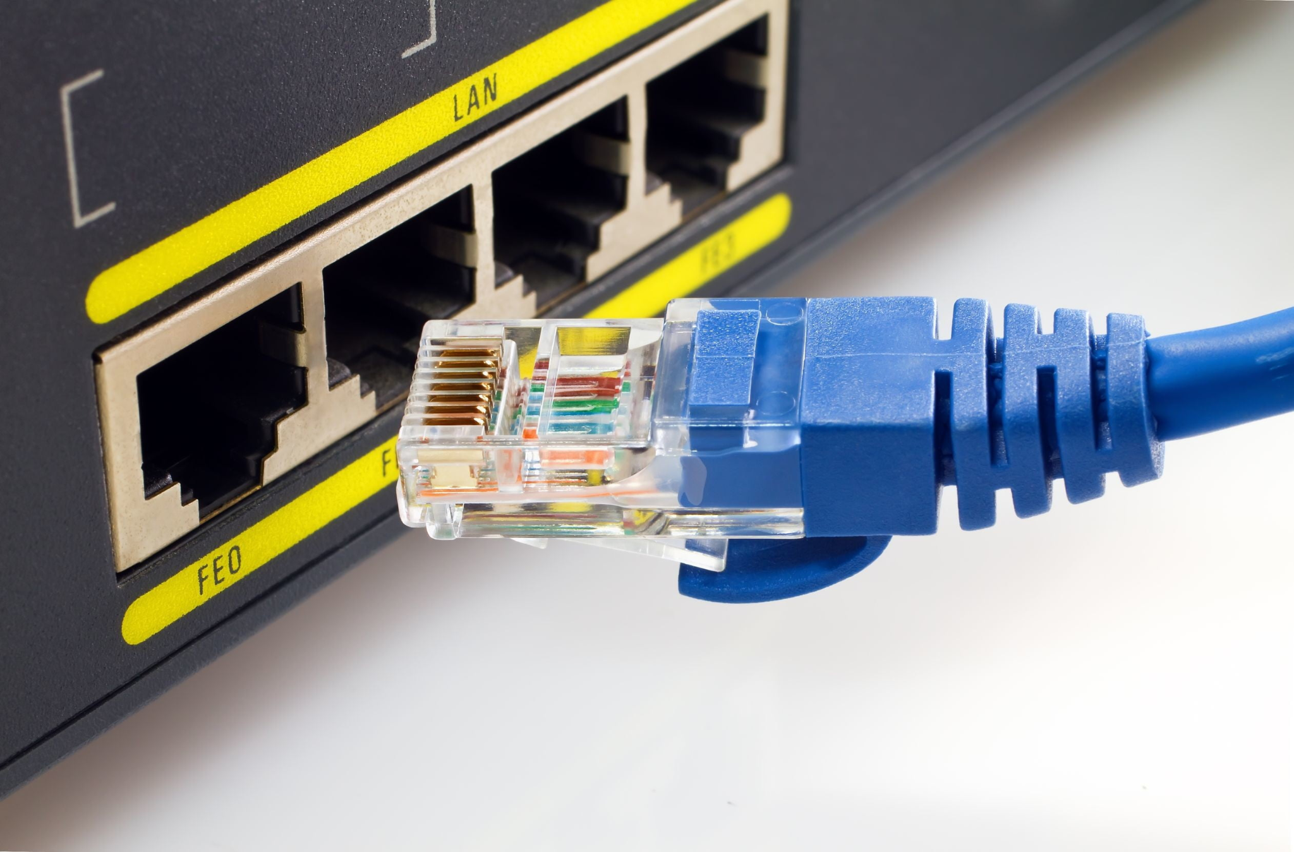
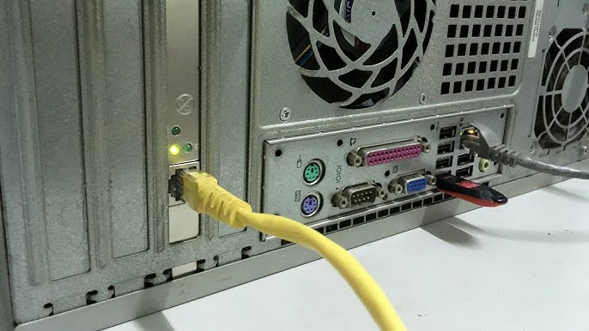
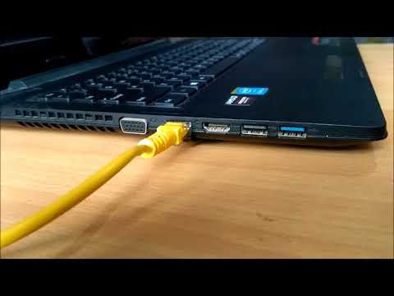
What Ethernet Defines
Physical Layer
Cabling
Connectors
… and more …
Data Link Layer
Device addressing (via MAC Addresses)
Media access control
Data frames
… and more ...

Slide 85
Network Devices

Slide 86
Common Network Devices
Repeater
Strengthens signals
Physical Layer
Router
Connects multiple networks
Uses IP for routing
Network Layer
Hub
Small LANs
No routing: cross-connects all devices
Not secure
Physical Layer
Firewall
Prevents unauthorized access
Port / protocol / IP based
Transport and Network Layer
Bridge
Creates exactly 2 segments
Limits collisions between segments
Data Link Layer
Intrusion Detection/Prevention (IDS/IPS)
Monitor and/or stop malicious activity
Performs “deep packet inspection”
Typically part of “next generation firewall”
Transport, Network, Application Layer
Switch
Connects devices on same network
Routes traffic based on MAC address
Data Link Layer

Slide 87

THANKS!
Any questions?

